Slide 1
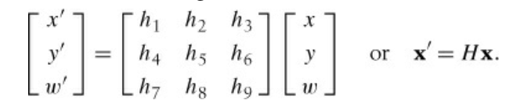
Image to Image Mappings
describes transformations between images and some practical methods for computing them.
Homographies A homography is a 2D projective transformation that maps points in one plane to another

Slide 2
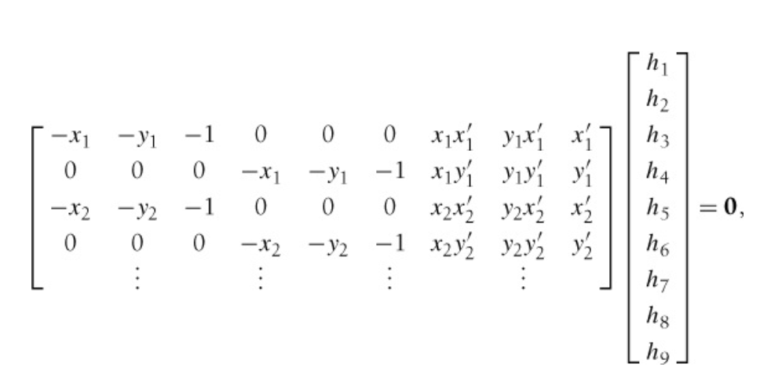
The Direct Linear Transformation Algorithm
The direct linear transformation (DLT) is an algorithm for computing H given four or more correspondences.

Slide 3
Warping Images
A warp can easily be performed with SciPy using the ndimage package.
The command
transformed_im=ndimage.affine_transform(im,A,b,size)
transforms the image patch im with A a linear transformation and b a translation vector as above.

Slide 4
Example
from scipy import ndimage
im=array(Image.open('empire.jpg').convert('L'))
H = array([[1.4,0.05,-100],[0.05,1.5,-100],[0,0,1]])
im2=ndimage.affine_transform(im,H[:2,:2],(H[0,2],H[1,2]))

Slide 5
Creating Panoramas
RANSAC RANSAC, short for “RANdom SAmple Consensus,” is an iterative method to fit models to data that can contain outliers.
Given a model, for example a homography between sets of points, the basic idea is that the data contains inliers,
the data points that can be described by the model, and outliers, those that do not fit the model.

Slide 6
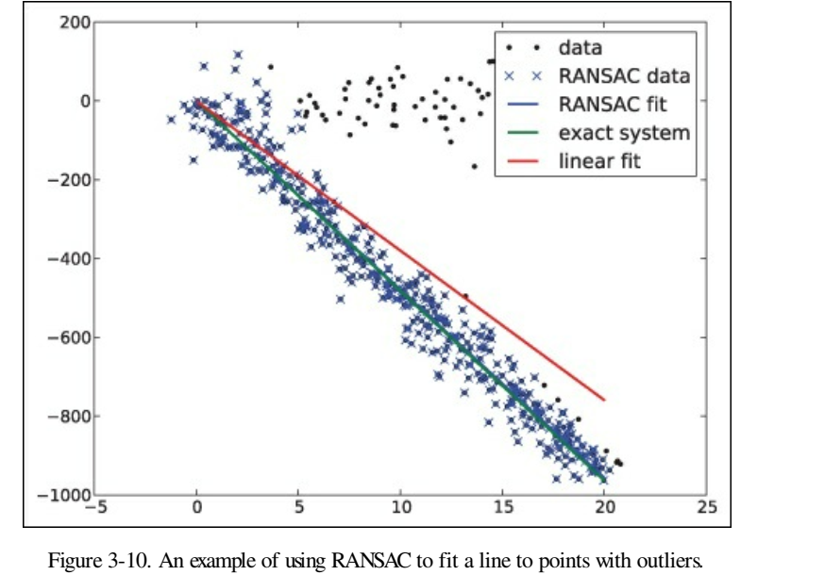

Slide 7
Camera Models and Augmented Reality
Here we show how to determine camera properties and how to use image projections for applications like augmented reality.
The Pin-Hole Camera Model
The pin-hole camera model (or sometimes projective camera model) is a widely used camera model in computer vision.
It is simple and accurate enough for most applications. The name comes from the type of camera
that collects light through a small hole to the inside of a dark box or room.
In the pin-hole camera model, light passes through a single point, the camera center, C, before it is projected onto an image plane

Slide 8
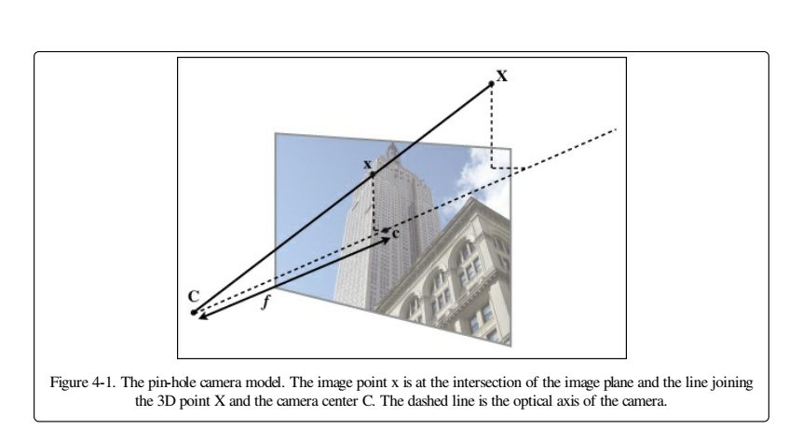

Slide 9
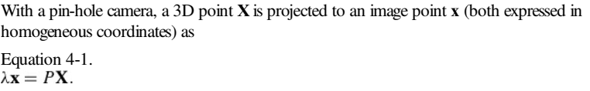
Here, the 3 × 4 matrix P is called the camera matrix (or projection matrix).
Note that the 3D point X has four elements in homogeneous coordinates, X = [X, Y, Z, W].
The scalar λ is the inverse depth of the 3D point

Slide 10

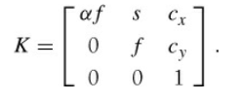
The Camera Matrix
The camera matrix can be decomposed as
where
R is a rotation matrix describing the orientation of the camera,
t a 3D translation vector describing the position of the camera center,
intrinsic calibration matrix K describing the projection properties of the camera. The calibration matrix depends only on the camera properties and is in a general form written as

Slide 11
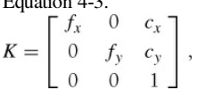

The focal length, f, is the distance between the image plane and the camera center.
The skew, s, is only used if the pixel array in the sensor is skewed
where we used the alternative notation fx and fy, with fx = αfy. The aspect ratio, α is used for non-square pixel elements. It is often safe to assume α = 1

Slide 12
Camera Calibration
Calibrating a camera means determining the internal camera parameters, in our case the matrix K
A Simple Calibration Method
Measure the sides of your rectangular calibration object. Let’s call these dX and dY.
Place the camera and the calibration object on a flat surface
Measure the distance from the camera to the calibration object.
Let’s call this dZ.
Take a picture and check that the setup is straight
--- meaning that the sides of the calibration object align with the rows and columns of the image.
Measure the width and height of the object in pixels.
Let’s call these dx and dy

Slide 13
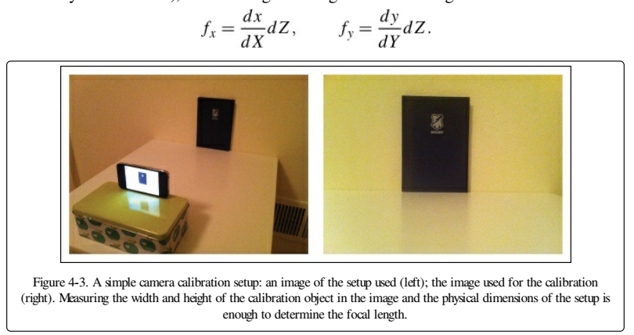

Slide 14
Pose Estimation from Planes and Markers
we saw how to estimate homographies between planes.
Combining this with a calibrated camera makes it possible to compute the camera’s pose (rotation and translation) if the image contains a planar marker object.
This marker object can be almost any flat object.

Slide 15
Augmented Reality
Augmented reality (AR) is a collective term for placing objects and information on top of image data
Example
PyGame and PyOpenGL

